Slide 1
TEAM 6 Crypto Average Wages

Slide 2
The Impact of cryptocurrencies on everyday life
What is worth of crypto currency in your country?
What if you were to travel to countries with cryptocurrency?
hat is your crypto worth when you travel?
What if you were paid by Cryptocurrency?
What would your wage be?
How would travel be impacted in various currencies?

Slide 3
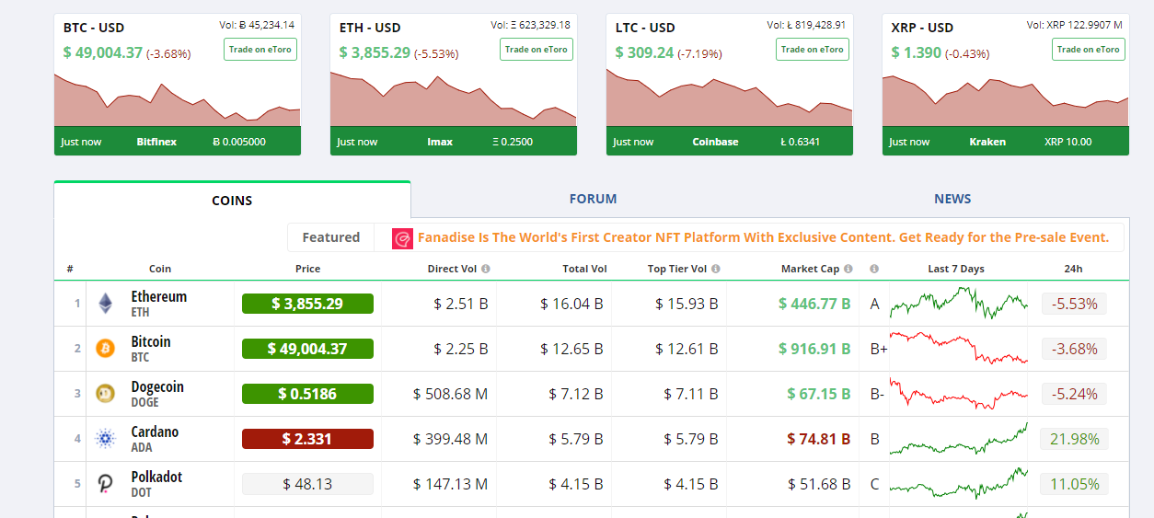
Crypto Compare - API

Slide 4
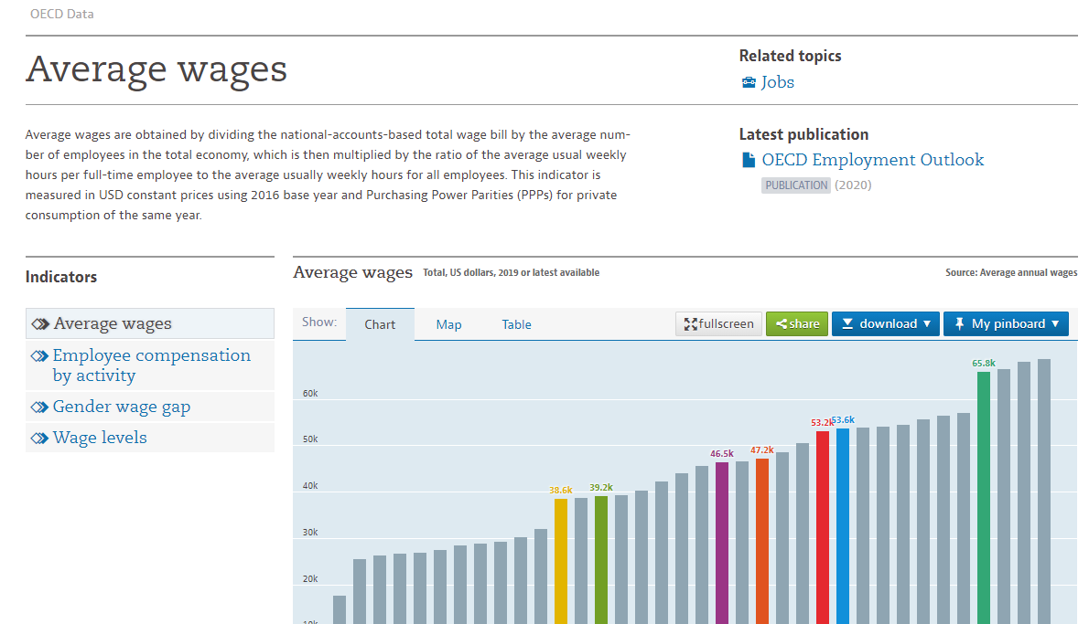
Average Wages

Slide 5
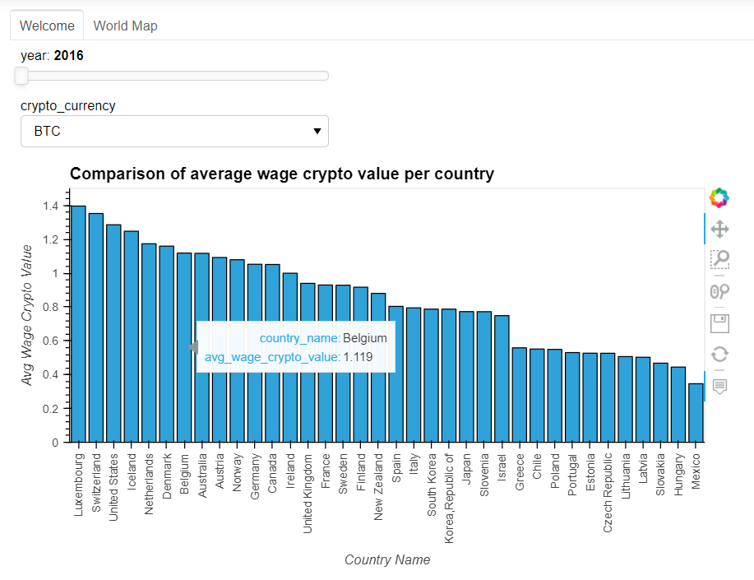
Comparison of average wage crypto value per country

Slide 6
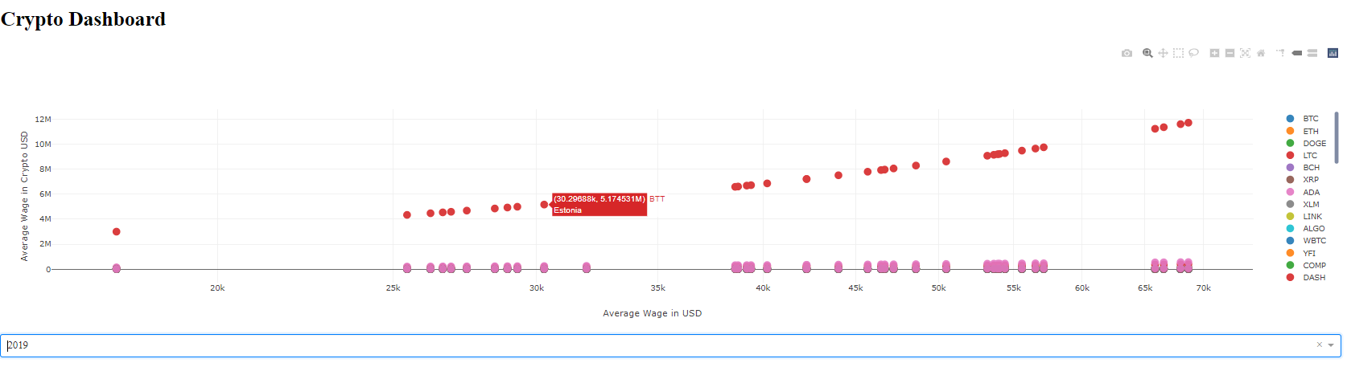
Dash Library – Dashboard 1

Slide 7
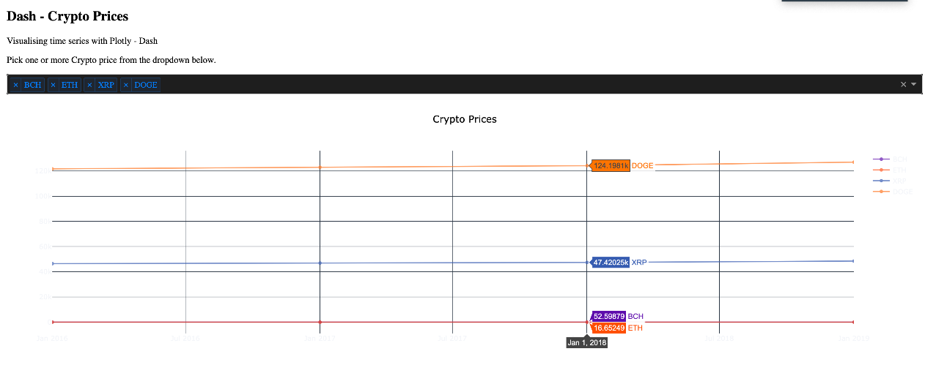
Dash Library – Dashboard 2

